Slide 1
IntraSoft Technologies Ltd
BSE: 533181, NSE: ISFT
May 27th, 2016

Slide 2
IntraSoft: Promoters
Arvind Kajaria
Arvind graduated with a Bachelors Degree in Business Administration from Adelphi University, New York. He has over 27 years of experience in finance, accounting, marketing and management. He is a member of the international fraternity of Delta Sigma Pi, an award winner of Dale Carnegie Training and the former president of the Young Entrepreneurs’ Organization, Kolkata.
Sharad Kajaria
Sharad has over 18 years of experience in internet technologies and has been associated with guiding development of technology solutions that drive our business growth. His understanding of new media with an intuitive sense for how technology and community blend together has been instrumental in our Company’s strategic technological initiatives.

Slide 3
IntraSoft Technologies Ltd.
Consolidated Revenue
 | Revenue (Rs. Cr.) | Y-o-Y %
Mar-10 | 29.20
Mar-11 | 42.75 | 46%
Mar-12 | 66.28 | 55%
Mar-13 | 88.24 | 33%
Mar-14 | 149.54 | 69%
Mar-15 | 343.33 | 130%
Mar-16 | 717.73 | 109%
Revenue Growth of 25x since IPO in 2010

Slide 4
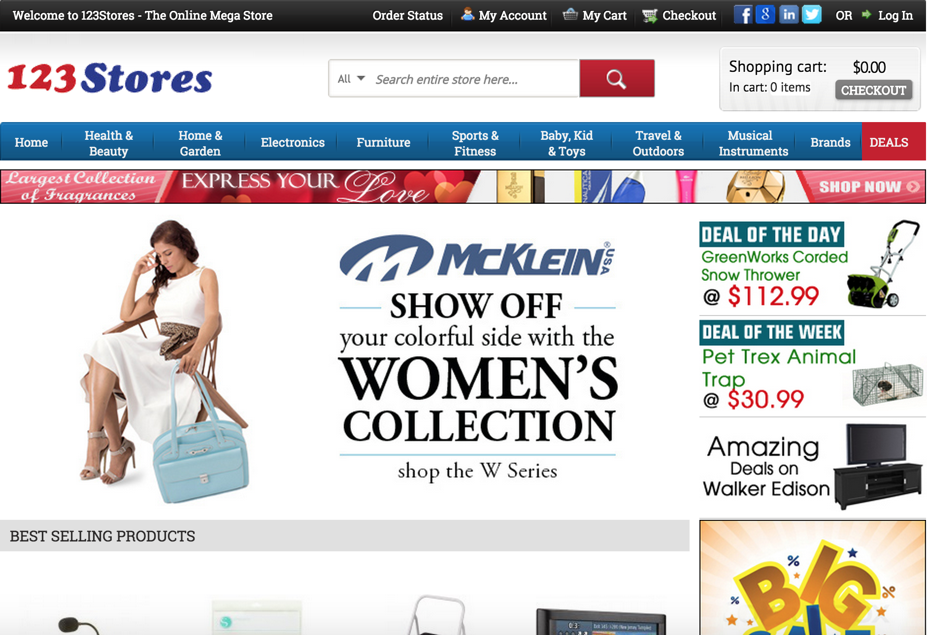
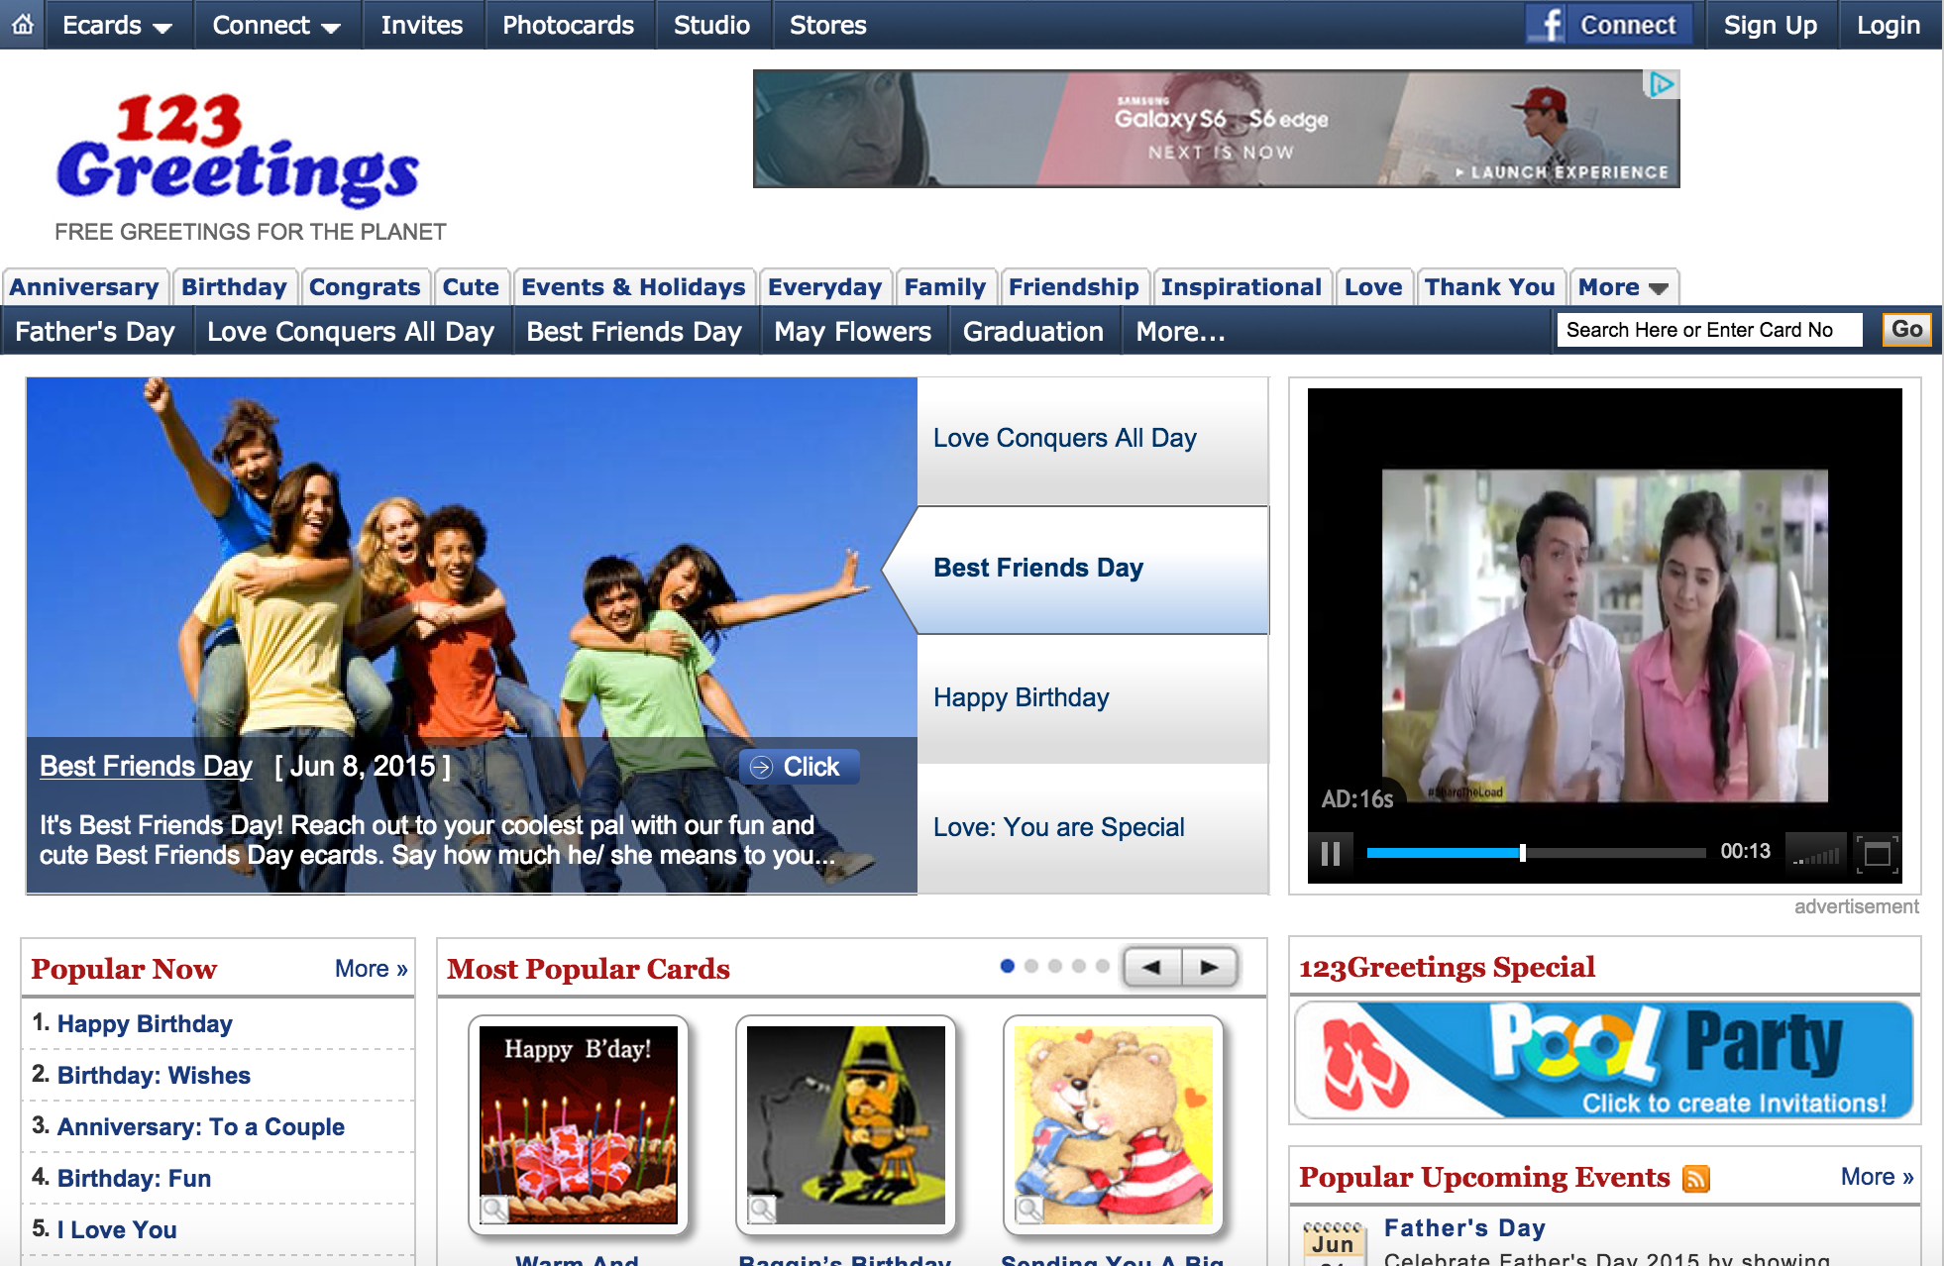
Our Businesses
123Stores.com
Online E-Commerce Retail
123Greetings.com
Online Advertising

Slide 5
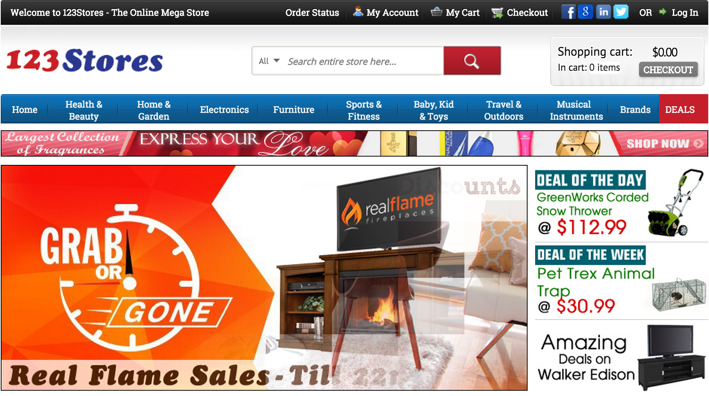
123Stores.com
Launched in 2009
#262 on Internet Retailer Top 500 Guide in 2016
#1641 on Inc. 5000 fastest growing US company
11th fastest growing online retailer in the US
Business Model
Online E-Commerce Retail
Revenues
FY2014-15 – Rs. 323 Cr.
FY2015-16 – Rs. 699 Cr.

Slide 6
123Stores.com: Website

Slide 7
123Stores.com: Catalog
Over 500,000 products for sale on the site.
Products sourced from over 1600 suppliers
Adding 10,000 new products every month
Top Product Categories by Revenues (FY2015-16)
Furniture, Patio, Lawn & Garden 30%
Musical Instruments & Gadgets 20%
Home Improvement & Art Crafts 14%
Kitchen, Dining & Appliances 13%
Toys, Games & Baby 11%
Sports & Outdoor 08%
Others 04%

Slide 8
123Stores.com: Operations
1,969,233 orders in FY2015-16
(772,981 orders FY2014-15).
Distribution Centers
East Coast (New York)
West Coast (Nevada)
Delivery to 95% of US zip codes in 2-3 business days
Partnerships with UPS & FedEx

Slide 9
123Stores.com: Sales
Shop in Shop Partnerships with leading retailers
Reach a larger audience
Lower customer acquisition costs
Better discounts from suppliers
Efficient Logistics
Amazon.com Ebay.com
Working since 2010 Working since 2011
Largest partner in FY2015-16 2nd largest partner in FY2015-16
Amazon Canada Alibaba’s 11main.com
Sears.com New Egg
Rakuten (buy.com) Bestbuy.com
Jet.com

Slide 10
123Greetings.com
Early Pioneers, launched in 1997
Leader in the E-greetings Category
Business Model
Online Advertising
Strategy
Promote user-generated content (studio)
Grow Mobile App traffic and revenue
Revenues
FY2015-16 – Rs. 17.8 Cr.

Slide 11
Disclaimer
This presentation and the accompanying slides (the “Presentation”), has been prepared by Intrasoft Technologies Limited (the “Company”), solely for information purposes and do not constitute any offer, recommendation or invitation to purchase or subscribe for any securities, and shall not form the basis or be relied on in connection with any contract or binding commitment whatsoever. No offering of securities of the Company will be made except by means of a statutory offering document containing detailed information about the Company.
This Presentation has been prepared by the Company based on information and data which the Company considers reliable, but the Company makes no representation or warranty, express or implied, whatsoever, and no reliance shall be placed on, the truth, accuracy, completeness, fairness and reasonableness of the contents of this Presentation. This Presentation may not be all inclusive and may not contain all of the information that you may consider material. Any liability in respect of the contents of, or any omission from, this Presentation is expressly excluded.
Certain matters discussed in this Presentation may contain statements regarding the Company’s market opportunity and business prospects that are individually and collectively forward-looking statements. Such forward-looking statements are not guarantees of future performance and are subject to known and unknown risks, uncertainties and assumptions that are difficult to predict. These risks and uncertainties include, but are not limited to, the performance of the Indian economy and of the economies of various international markets, the performance of the Retail industry in India and world-wide, the performance of the Greetings Industry in India and world –wide, competition, the company’s ability to successfully implement its strategy, the Company’s future levels of growth and expansion, technological implementation, changes and advancements, changes in revenue, income or cash flows, the Company’s market preferences and its exposure to market risks, as well as other risks. The Company’s actual results, levels of activity, performance or achievements could differ materially and adversely from results expressed in or implied by this Presentation. The Company assumes no obligation to update any forward-looking information contained in this Presentation. Any forward-looking statements and projections made by third parties included in this Presentation are not adopted by the Company and the Company is not responsible for such third party statements and projections.

Slide 12
IntraSoft Technologies Ltd
For further information, please contact
Company : | Investor Relations Advisors :
IntraSoft Technologies Ltd. CIN - L24133MH1996PLC197857 Ms. Purvangi Jain purvangi.jain@itlindia.com 91-22-2491-2123 www.itlindia.com www.123stores.com www.123greetings.com | Strategic Growth Advisors Pvt. Ltd. CIN - U74140MH2010PTC204285 Mr. Shogun Jain jshogun@sgapl.net 91-7738377756 Mr. Vivek Jain jvivek@sgapl.net 91-9820207011 www.sgapl.net

