Slide 1
IntraSoft Technologies Ltd
BSE: 533181, NSE: ISFT
July 20, 2015

Slide 2
Intrasoft: Promoters
Arvind Kajaria
  Arvind graduated with a Bachelors Degree in Business Administration from Adelphi University, New York. He has over 27 years of experience in finance, accounting, marketing and management. He is a member of the international fraternity of Delta Sigma Pi, an award winner of Dale Carnegie Training and the former president of the Young Entrepreneurs’ Organization, Kolkata.
Sharad Kajaria
  Sharad has over 18 years of experience in internet technologies and has been associated with guiding development of technology solutions that drive our business growth. His understanding of new media with an intuitive sense for how technology and community blend together has been instrumental in our Company’s strategic technological initiatives.

Slide 3
Intrasoft Technologies Ltd.
Consolidated Revenue
 | Revenue (Rs. Cr.) | Y-o-Y %
Q1 2013-14 | 23.75 | 30%
Q1 2014-15 | 59.78 | 152%
Q1 2015-16 | 118.00 | 97%
Quarterly Revenue Growth of 4x in the last 2 years

Slide 4
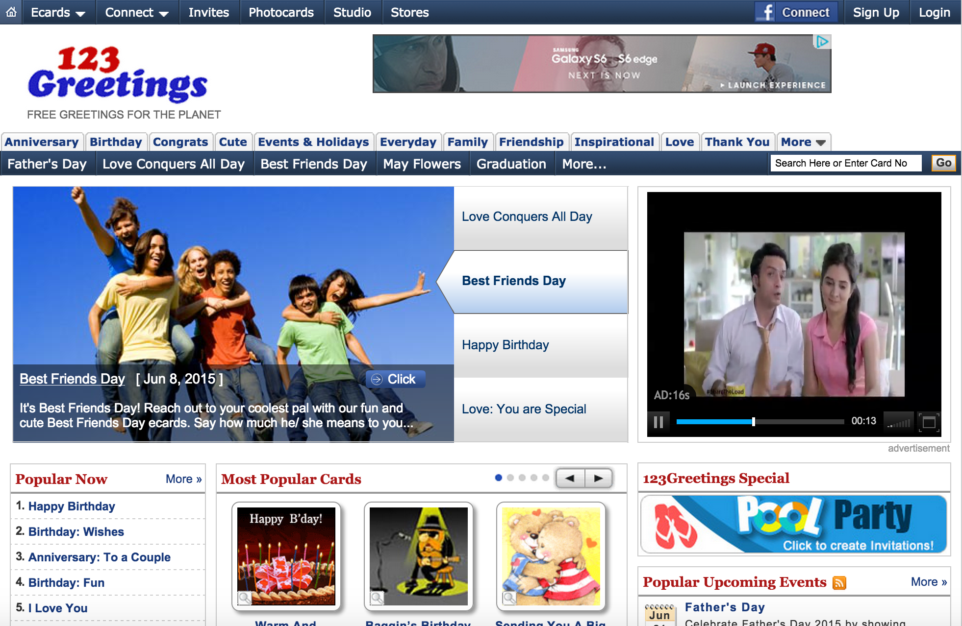
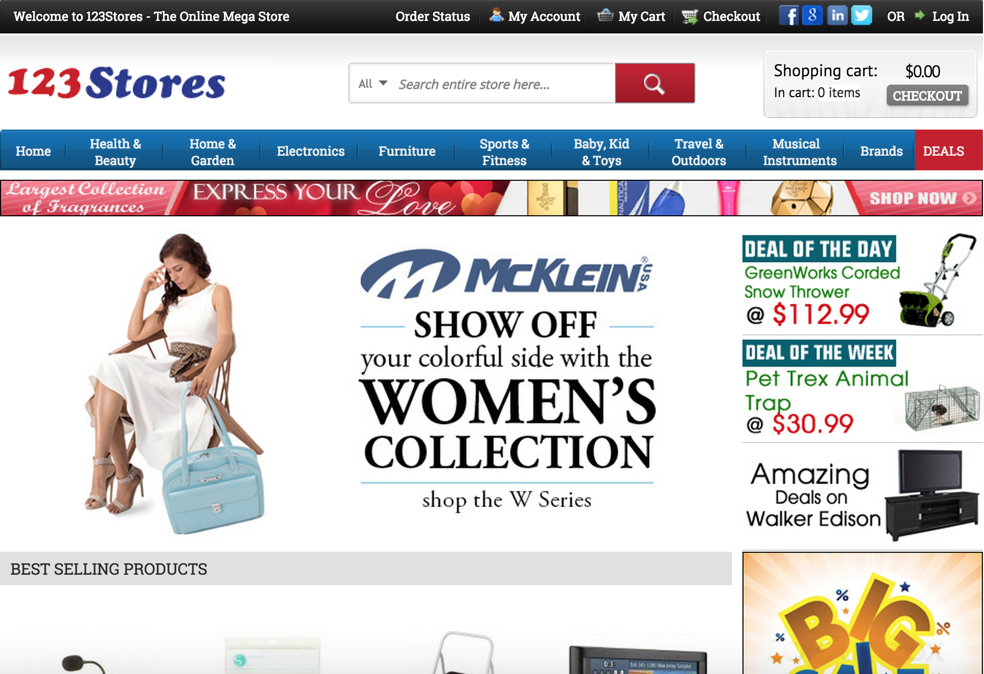
Our Businesses
123Greetings.com
  Online Advertising
123Stores.com
  Online E-Commerce Retail

Slide 5
123Greetings.com
Early Pioneers, launched in 1997
Leader in the E-greetings Category
Business Model
    Online Advertising
Strategy
    Promote user-generated content (studio)
    Grow Mobile App traffic and revenue
Revenues
    Q1 FY2014-15 – Rs. 5.6 Cr.
    Q1 FY2015-16 – Rs. 4.4 Cr.

Slide 6
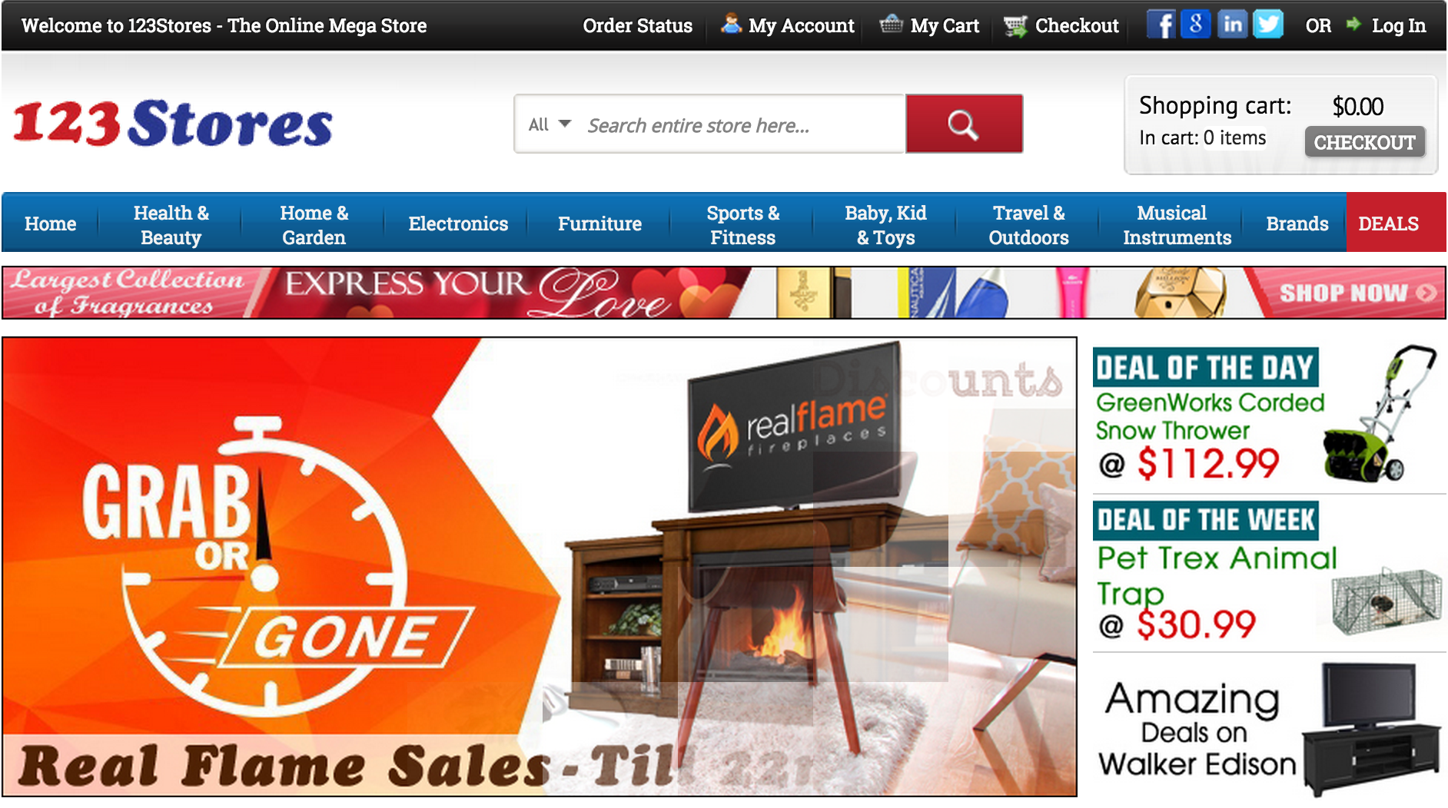
123Stores.com
Launched in 2009
  #392 on Internet Retailer 500 in 2015
  #1654 on Inc. 5000 fastest growing US company
  13th fastest growing online retailer in the US
Business Model
  Online E-Commerce Retail
Revenues
  Q1 FY2014-15 – Rs. 54 Cr.
  Q1 FY2015-16 – Rs. 113 Cr.

Slide 7
123Stores.com: Website

Slide 8
123Stores.com: Catalog
Over 200,000 products for sale on the site.
Products sourced from over 1300 brands
Adding 10,000 new products every month
Top 6 Product Categories by Revenues (Q1 FY2015-16)
    Furniture, Patio, Lawn & Garden 36%
    Musical Instruments & Gadgets 17%
    Home Improvement & Art Crafts 16%
    Kitchen, Dining & Appliances 13%
    Sports & Outdoor 07%
    Toys, Games & Baby 05%

Slide 9
123Stores.com: Operations
293,894 orders shipped out in Q1 FY2015-16
  (116,081 orders Q1 FY2014-15).
Average Order Value in Q1 FY2015-16 = Rs. 3857
Distribution Centers
  East Coast (New York)
  West Coast (Nevada)
Delivery to 95% of US zip codes in 2-3 business days
Partnerships with UPS & FedEx

Slide 10
123Stores.com: Sales
Shop in Shop Partnerships with leading retailers
  Reach a larger audience
  Lower customer acquisition costs
  Better discounts from suppliers
  Efficient Logistics
Amazon.com Ebay.com
  Working since 2010 Working since 2011
  Largest partner in FY2014-15 2nd largest partner in FY2014-15
Amazon Canada Alibaba’s 11main.com
Sears.com New Egg
Rakuten (buy.com) Bestbuy.com

Slide 11
IntraSoft Technologies Ltd
For further information, please contact
$12 Billion
Company : | Investor Relations Advisors :
IntraSoft Technologies Ltd. CIN - L24133MH1996PLC197857 Ms. Purvangi Jain purvangi.jain@itlindia.com 91-22-2491-2123 www.itlindia.com | Strategic Growth Advisors Pvt. Ltd. CIN - U74140MH2010PTC204285 Mr. Shogun Jain jshogun@sgapl.net 91-22-6114-6619 Ms. Sanjita Ghosh gsanjita@sgapl.net 91-22-6114-6619 www.sgapl.net
$124 Billion

